Slide 1

Overview of Public Facing ODJFS Child Welfare Dashboards
February 25, 2019
Ohio SACWIS Project
The webinar will begin at 1:00 pm

Slide 2
Agenda
Dashboard Background Information
Information on Data
Information on Specific Dashboards
  Population
  Periodicity
  Drilldowns
Questions

Slide 3
Background
Since July 2016, ODJFS has fielded over 400 data requests
The goal for the Public Facing Data Dashboards is to:
Decrease the influx of data requests fielded by ODJFS
Decrease the data requests fielded by each PCSA
Provide accurate child welfare information for the public
Transparency

Slide 4
Background Continued
ODJFS partnered with Ohio Department of Administrative Services to create a visual dashboard experience.
Tableau was selected as the data visualization tool. Tableau provides an interactive design for users.
Users will not be required to have Tableau to use the dashboards. The dashboards will be located on a dedicated URL.
Users will be able to manipulate data using predetermined filters within the Tableau dashboard.
Data will be refreshed on delay as opposed to real time. The refresh interval will be quarterly.
Dashboards will allow users to view Statewide or County specific visualizations.

Slide 5


Data
There is no direct transfer of confidential, detailed information from the Office of Families and Children (OFC) to the Department of Administrative Services.
Data will be aggregated by OFC in the Oracle database and then extracted and uploaded into the Tableau application. Any ID associated with a Case, Person or Intake will be encrypted prior to the data extract.
If the distinct count for a single county is less than 15, the drilldown options for the dashboard will not be available.
Certain values have been mapped within the extract.
Aggregate Data extracted from
Tableau Application
UPLOAD

Slide 6
Available Dashboards
Point in Time Count of Children in Care – the base population for this dashboard is point in time data with a count of children in custody.
Point in Time Count of Participants on an Open Child Abuse and Neglect Case – the base population for this dashboard is point in time data with a count of active case participants on open cases.
Child Abuse and Neglect Referrals and Outcomes – the base population for this dashboard is CA/N and Stranger Danger intakes received during a period of time.
Children Removed from the Home due to Parental Substance Use/Abuse – the base population for this dashboard looks at all removals and displays the percentage of those that have parental substance abuse/use prevalence as a removal reason during a period of time.
Adoption Related Summary – the base population for this dashboard is children in permanent custody during the period.
Summary of Children Removed During the Period – the base population for this dashboard is removals during the period.
Summary of Children Discharged from Care During the Period – the base population for this dashboard is discharges from custody during the time period.

Slide 7
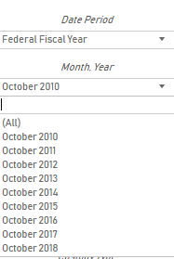
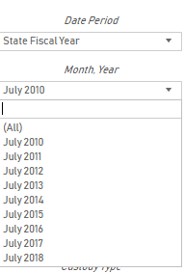
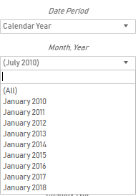
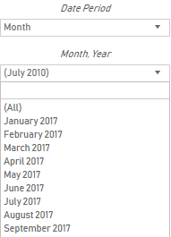
Drilldown Options For All Dashboards
Date Period
Federal Fiscal Year
State Fiscal Year
Calendar Year
Month
Month and Year
This drilldown depends on the Date Period Selected
Federal Fiscal Year October 1 – September 30 (all dates begin October 1, YYYY)
State Fiscal Year July 1 – June 30 (all dates begin July 1, YYYY)
Calendar Year January 1 – December 31 (all dates begin January 1, YYYY)
Month (all dates begin with the first day of the Month selected)
Some dashboards are POINT IN TIME and some are PERIOD OF TIME

Slide 8
Drilldown Options For All Dashboards continued
Agency Type
Juvenile Court Agencies
Includes the 40 Ohio Juvenile Court Agencies
Public Child Welfare Agencies
Includes the 88 PCSAs
Franklin County CSB – NYAP
Franklin County CSB – PFSN
(Franklin County Managed Care agencies will be mapped to Franklin County CSB)
Ohio Department of Youth Services
Age Group
Newborn
2-11 Months
1-3 Years
4-6 Years
7-9 Years
10-12 Years
13-15 Years
16-18 Years
19-21 Years
Over 21 Years
Unknown
Dashboards will offer a Statewide count and the ability to view any combination of available agencies.

Slide 9
Dashboard #1 – Point in Time Count of Children in Care
[POINT IN TIME]
Available Drilldown Filters
Age Group
Custody Type
Derived from Participant Legal Action Information → Legal Action in SACWIS
Permanent
Planned Permanent Living Situation
Temporary
Placement Type
Derived from Case → Workload → Placements → Service Information → Placement Type in SACWIS
Congregate Care
Family Foster Care
Independent Living
Kinship Care
Other
ROM Report
Foster Care Counts
Placement Type

Slide 11
Dashboard #2 – Point in Time Count of Participants on an Open Child Abuse and Neglect Case
[POINT IN TIME]
Available Drilldown Filters
Age Group
Case Category
Derived from Case → Workload → Case Information → Case Category in SACWIS
Adoption
Alternative Response Intake
Ongoing
Other
Traditional Response Intake
Young Adult Services

Slide 13
Dashboard #3 – Child Abuse and Neglect Referrals and Outcomes
[PERIOD OF TIME]
Available Drilldown Filters
Screening Decision with Screened Out Reason
Screening Decision is derived from Intake Workspace → Decision Details → Screening Decision in SACWIS
Screened Out Reason is Derived from Intake Workspace → Decision Details → Decision → Reason for screening out in SACWIS
Screened In
Screened In AR
Screened Out – Currently Being Investigated
Screened Out – Does Not Meet Criteria for Investigation
Screened Out – Not Available
Screened Out – Referred to Another Public Children Services Agency
SACWIS Report - Intake Details and Statistics

Slide 14
Dashboard #3 – Child Abuse and Neglect Referrals and Outcomes [PERIOD OF TIME]
Available Drilldown Filters continued
Intake Type
Derived from Intake Workspace → Basic → Intake Type → Intake Category in SACWIS
Baby Doe/Disabled Infant
Emotional Maltreatment
Multiple
Neglect
Physical Abuse
Sexual Abuse
Stranger Danger
Disposition
Derived from Case→ Workload → Intake → Intake Dispositions → Disposition in SACWIS
Alternative Response
Indicated
Other
Substantiated
Unsubstantiated

Slide 17
Dashboard #4 – Children Removed from the Home due to Parental Substance Use/Abuse
[PERIOD OF TIME]
The only available drilldown filters for this dashboard are Date Period, Month/Year, Agency Type and Agency Name.
Derived from Case → Workload → Initial Removal → Child Removal from Home Information → Selected Removal Reasons in SACWIS
Removals With Parental Substance Abuse/Use Prevalence
Total Removals
Percentage
ROM Report – Removal Reasons for Children Entering Foster Care

Slide 18
Dashboard #5 – Adoption Related Summary
[PERIOD OF TIME]
Available Drilldown Filters
This dashboard utilizes Adoption Measures as Drilldown Filters
Available for Adoption
Derived from Participant Legal Action Information → Legal Action in SACWIS
Distinct count of all children in Permanent Custody during the time period selected.
Exit Custody, Not Finalized
Derived from Legal Custody/Status → Legal Custody Episode & Status Information → Legal Status → Termination Reason in SACWIS
Distinct count of all children who exited Permanent Custody without finalization during the time period selected.
Adoption Finalized
Derived from Adoption Finalization Checklist Information → Finalization Information → Checklist Details → Ruling Adoption Finalization Date in SACWIS
Distinct count of all children whose Adoption Finalized during the time period selected.
Entered Custody
Legal Custody/Status → Legal Custody Episode & Status Information → Custody Episode Start Date in SACWIS
Distinct count of all children who entered Permanent Custody status during the time period selected.
Exited Custody
Legal Custody/Status → Legal Custody Episode & Status Information → Custody Episode End Date in SACWIS
Distinct count of all children who exited Permanent Custody status during the time period selected.

Slide 19
ROM Report
Countdown to Adoption/Other Permanency
Number of children who were granted TPR
Children adopted or achieved permanency
Children who were discharged but did not achieve permanency
Children remaining in care
Adopted in less than 12 months of TPR

Slide 20
Dashboard #6 – Summary of Children Removed During the Period [PERIOD OF TIME]
Available Drilldown Filters
Reason for Termination and Caretaker Structure are dependent on the Removal Reason measure selected
Age Group
Removal Reason
Derived from Case → Workload → Initial Removal → Removal Information → Child Removal from Home Information → Selected Removal Reasons in SACWIS
Abandonment/Relinquishment
Abuse
Neglect
Parental Problems with Child
Parent/Family Issues
Custody Type
Derived from Participant Legal Action Information → Legal Action in SACWIS
Permanent
Planned Permanent Living Situation
Temporary
Caretaker Structure
Derived from Case → Workload → Initial Removal → Removal Information → Child Removal from Home Information → Caretaker Structure in SACWIS
One Parent Household
Other
Relative
Two Parent Household
ROM Report – Removal Reasons for Children Entering Foster Care

Slide 24
Dashboard #7 – Summary of Children Discharged from Care During the Period
[PERIOD OF TIME]
Available Drilldown Filters
Age Group
Custody Type
Derived from Participant Legal Action Information → Legal Action in SACWIS
Permanent
Planned Permanent Living Situation
Temporary
Reason for Termination
Derived from Case → Workload → Initial Removal → Removal Information → Child Removal from Home Information → Custody Discharge Reason and Legal Custody/Status → Legal Custody Episode & Status Information → Termination Reason in SACWIS
Not Applicable
Reunification with Parent(s) or Primary Caretaker
Living with Other Relatives
Adoption
Emancipation
Guardianship
Transfer to Another Agency
Runaway
Death of a Child
Missing or Unknown
This dashboard will also display the average
Days Spent In Custody!
ROM Report – Federal Discharge Reason

Slide 27
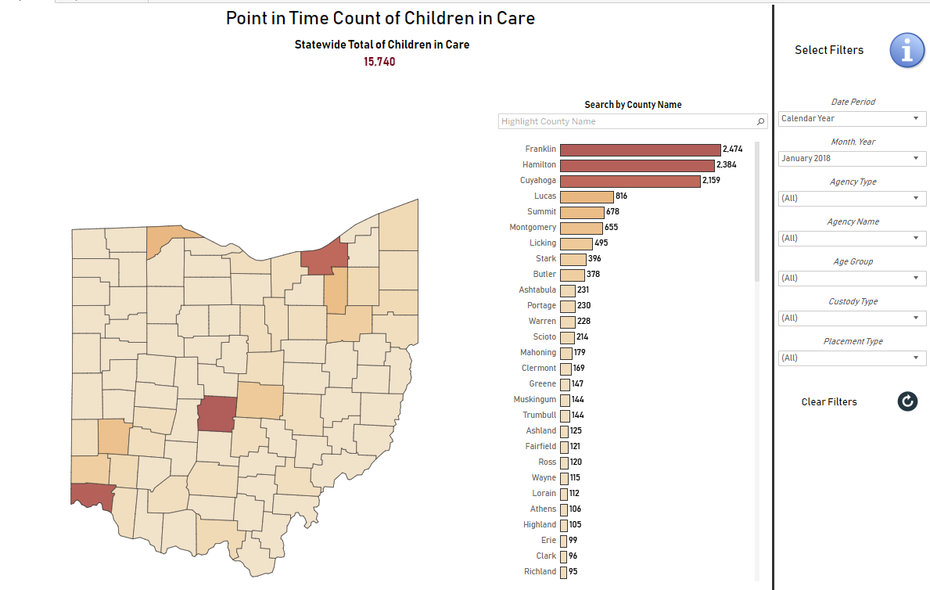

Slide 28
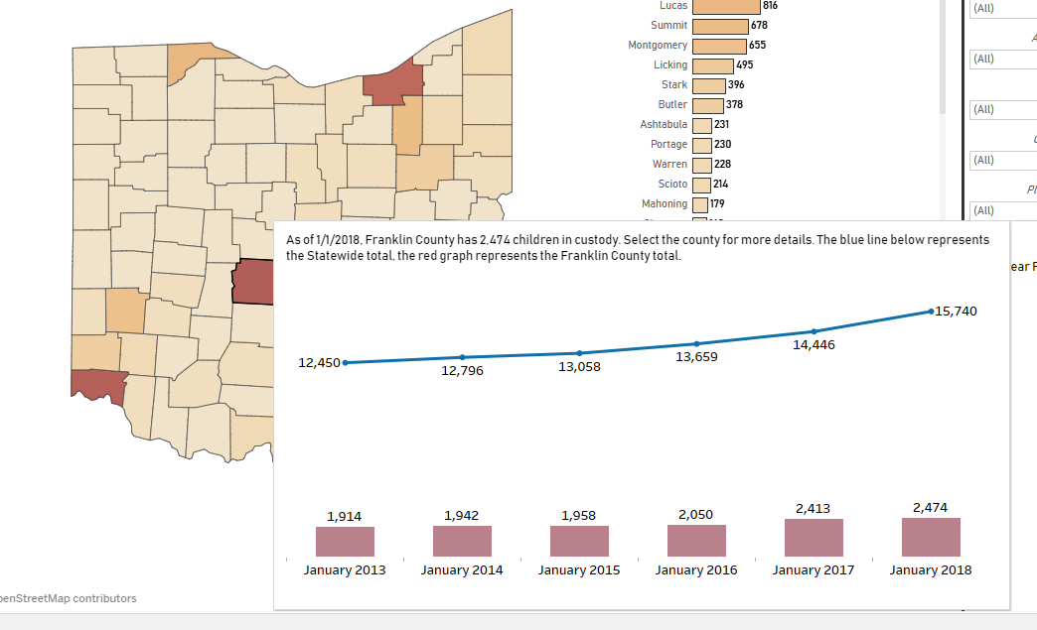

Slide 29
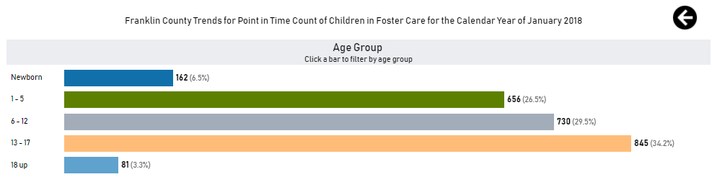
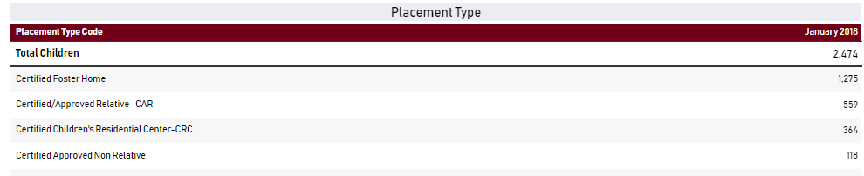

Slide 30
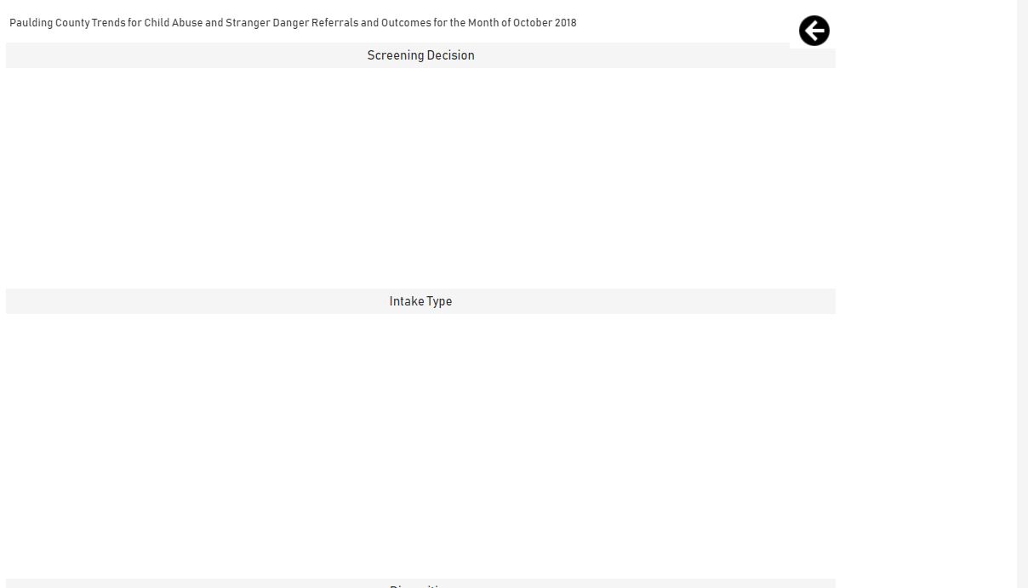

Slide 31
QUESTIONS?

Slide 32
Contacts:
Chris Beach – christopher.beach@jfs.ohio.gov
Jennifer Watson – jennifer.Watson@jfs.ohio.gov

